Slide 1
BUILDING THE FUTURE TOGETHER
November 3, 2017
Kingston, Ontario

Slide 2
9:15 – 10:00am Algonquin Land Claims Sydne Taggart – Ministry of Indigenous Relations and Reconciliation

Slide 3
Algonquin Land Claims
In order to be successful a band must demonstrate exclusive, continued and sufficient occupation of the land (sufficient = regular use, recognized by others as your property). This definition came out of the Supreme Court decision in 2004 of the TSILHQOT’IN vs. BC.
The Algonquins demonstrated that within the Constitution, Section 25, they were mentioned in the Royal proclamation of 1763.
They are seeking Aboriginal title – similar to fee simple.
They have made 26 petitions from 1762 to 1895 for recognition of their title to the land.
In 1985 they made another petition based upon Aboriginal title and in 1992 it was decided it was a valid petition for recognition. Work began in 2008 and in 2013 was the establishment of land areas.
Today – the area under review is most of eastern Ontario and the Algonquins have set up an office that reviews potential land uses and developments upon which they can review, provide comment, etc

Slide 4
10:00 – 10:45am Elements of a Successful Negotiation Guillaume Lavictoire, Scargall Owen-King LLP

Slide 5
What is a negotiation?
Google: discussion aimed at reaching an agreement
Wikipedia: negotiation is a dialogue between two or more people or parties intended to reach a beneficial outcome

Slide 6
Elements of a Successful Negotiation
Why do negotiations fail?
Focus on interests
Identifying interests
Look to create options for mutual gain
Apply objective criteria
Develop alternatives (knowing your BATNA)
Effective Communication
Be mindful of the relationship

Slide 7
11:00 – 12:00pm LRT Stage 2 Bundling of Projects MTO & City of Ottawa
Kelly Boudreau
Nicolas Delahousse

Slide 8
Kate Green - Ministry of Transportation

Slide 9
1:00 – 2:00pm Excess Soil Management – New Ontario Regulations City of Ottawa
Brad Carew
Richard Barker

Slide 10
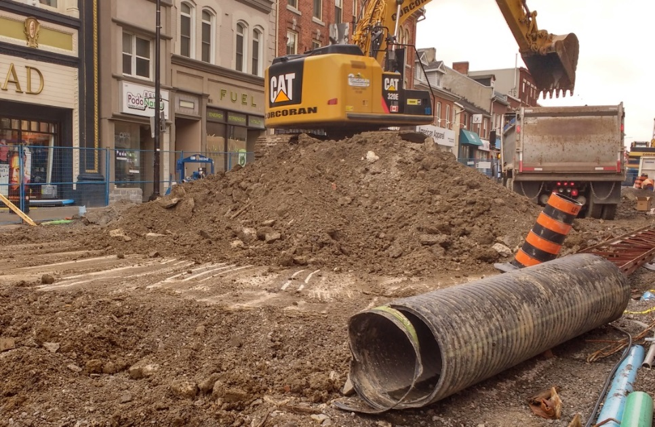
Excess Soil Management – City of Kingston
Brodie Richmond

Slide 11
New soil standards for excess soils = additional level of complexity
Do we want to get into the soil banking industry
Do we want to get into the soil disposal industry?
Four open landfills in Ottawa need cover
When the proposed regulation is going to be released

Slide 12
2:00 – 2:30 Proposed Changes to the Expropriations Act Rob Piper - Ministry of Transportation on behalf of the OEA

Slide 13
2:45 – 3:30pm Private / Public Partnerships Steve Dyck, Vice President for Ontario Government Relations for SNC-Lavalin Inc.

Slide 14
Tracey Larkin, SR/WA

